Slide 1

Chicago Crime Analysis Phase 2
Miguel Fernandez

Slide 2
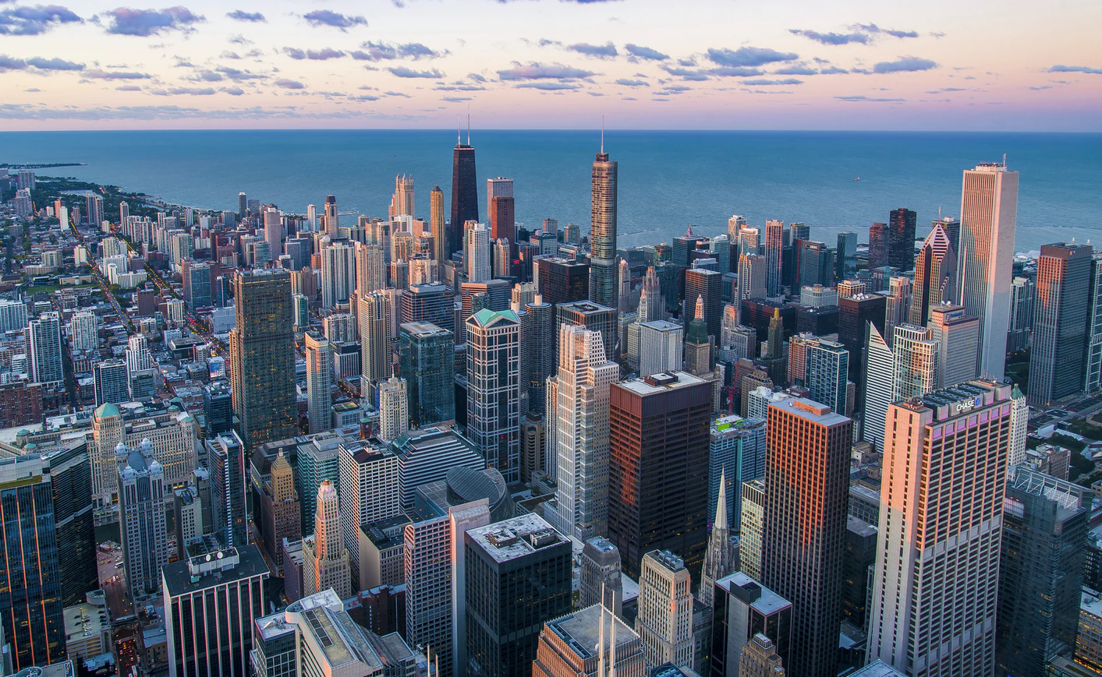
OUtline
Introduction
Model Efforts
Recommendation
Source: unsplash.com, Pedro Lastra

Slide 3

Introduction
Three models were used
Used a subset of variables as predictors
Was an arrest made?
Source: https://online.pointpark.edu/criminal-justice/policing-law-enforcement-and-technology/

Slide 4


First model
Random forest model
Calculated variable importance
Accuracy ~85%
Unbalanced metrics
Source: https://media.nesta.org.uk/images/Predictions-2019_Twitter_02.width-1200.png,
https://img2.pngio.com/christmas-tree-pine-clip-art-forest-clipart-png-download-1280-forest-art-png-1280_896.png

Slide 5

Second model
Neural network
Reinforcement learning
Higher accuracy ~87%
Improved metrics
Source: https://tdwi.org/articles/2020/03/23/adv-all-future-of-work.aspx

Slide 6
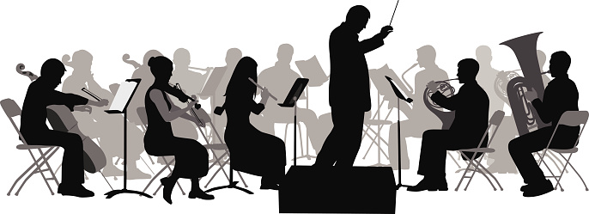
Third model
Ensemble model
Did not perform as well as the neural network
Degradation in model accuracy
Unnecessary model complexity
Source: https://cdn.analyticsvidhya.com/wp-content/uploads/2017/02/12170401/ensemble.jpg

Slide 7

recommendation
Further improvements need to be made before deployment
Current performance will lead to ineffective allocation of resources
Source: https://cms-assets.tutsplus.com/uploads/users/23/posts/29866/image/how-to-write-a-good-recommendation-letter.jpg

